Slide 1


Professional Bodies and the NQF
The RECOGNITION function, challenges and successes

Slide 2

ABOUT SAQA
THE SOUTH AFRICAN QUALIFICATIONS AUTHORITY (SAQA) IS A STATUTORY BODY, ESTABLISHED IN TERMS OF THE SAQA ACT (NO. 58 OF 1995) AND CONTINUING IN TERMS OF THE NQF ACT (NO. 67 OF 2008) AND ACCOUNTABLE TO THE MINISTER OF HIGHER EDUCATION, SCIENCE AND INNOVATION
THE NQF ACT MANDATES SAQA TO
DEVELOP AND
IMPLEMENT A
NATIONAL
QUALIFICATIONS
FRAMEWORK (NQF)
ADVANCE THE
OBJECTIVESOF
THE NQF
CO-ORDINATE THE
SUB-FRAMEWORKS OF
THE NQF
Based in Pretoria, South Africa

Slide 3
SAQA RESPONSIBILITIES
REGISTER
OVERSEE
qualifications and professional designations on the NQF
PROVIDE
CONDUCT
NQF implementation and co-ordinate NQF Sub-Frameworks
DEVELOP
evaluation and advisory services for foreign qualifications
research and collaborate with international counterparts
and implement NQF policies and criteria
ADVISE
MAINTAIN
RECOGNISE
PROVIDE
INFORM
the Minister of Higher Education and Training on NQF matters
a National Learners’ Records Database
professional bodies
verification services for national qualifications
the public about the NQF

Slide 4
SOUTH AFRICAN NQF
The NQF is a comprehensive system approved by the Minister for the classification, registration, publication and articulation of quality assured national qualifications.
The NQF is a conceptual ‘ladder’ of increasing cognitive complexity that enables evaluations of parity for registered qualifications across its three sub-frameworks and global frameworks
Professional bodies and designations are registered on a separate register of the MIS

Slide 5

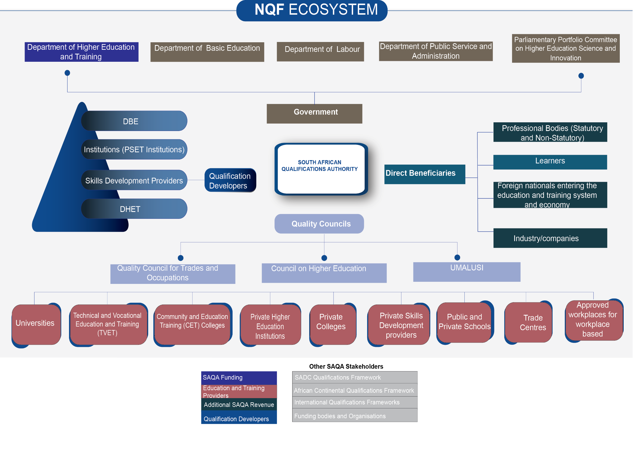

Slide 6
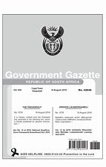

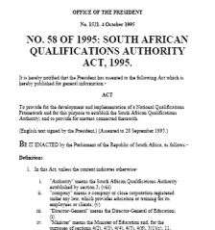
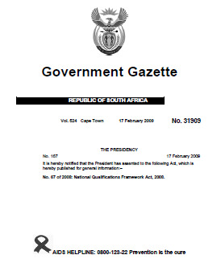



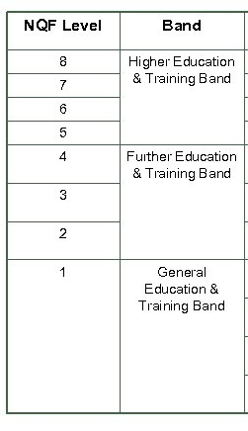
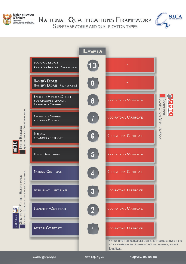

The recent and evolving role of Professional Bodies in the NQF
Pre’94
1995
2007
2008
2017
2019
1994
2002
2021
NQFAct Amendments
Proclaimed October 2023
Study Team Report
Dawn of democracy in South Africa
SAQA Act No 58 of 1995
NQF Act implementation evaluation
2003
NQF Act No 67 of 2008
NQF Amendment Act 12 of 2019
Joint Policy Statement: Education and Labour
1996- 98
2009
Consultative document
Apartheid
PB

Slide 7
2005 Review
SAQA appointed a Review Panel on Professional Qualifications comprised of eight nominated recognised individuals from professional bodies, to make recommendations to SAQA after engaging in a broad consultation process which ended in 2006.
Ultimately, the recognition of the importance of professional bodies, and the improved understanding of professional qualifications and professional designations provided in the recommendations of the Review Panel on Professional Qualifications contributed to the NQF Act that was promulgated at the end of 2008. (The role of professional bodies in skills acquisition in South Africa: Comments on two research reports submitted to JIPSA – Sep 2009. SAQA comments on JIPSA reports)
One of the key recommendations of the Review Panel was that professional designations should be recognised as being separate from professional qualifications.

Slide 8
2005 Review
The ministries (DOL and DOE) at the time wanted a ‘complete’ and integrated PSET sector (inclusive of PBs);
It became important to ensure that exclusionary practices did not occur in respect of the career pathing of black professionals in some sectors – removing blockages – ensuring access;
The Minister wanted a record of professionals as part of monitoring critical skills
eliminate any confusion with regard to recognised professional bodies and “bogus” professional bodies or expert groups.
Professional bodies/ designations
NQF Act 2008

Slide 9

NQF Act no 67 of 2008
3 (a) (b) Applies to qualification and professional designations
13 (i) SAQA must develop and implement policy and criteria for recognising a professional body and registering a professional designation for the purposes of this Act, after consultation with statutory and nonstatutory bodies of expert practitioners in occupational fields and with the QCs; and
(ii) recognise a professional body and register its professional designation if the criteria contemplated in subparagraph (i) have been met;
29 . A statutory or non-statutory body of expert practitioners in an occupational field must apply in the manner prescribed by the SAQA in terms of section 13(1)(i)(i) to be recognised as a professional body in terms of this Act.
30 A professional body that is recognised in terms of section 29 must apply to the SAQA, in the manner determined by the SAQA in terms of section 13(1)(i)(ii), to register a professional designation on the NQF.
31 A professional body must, in consultation with the SAQA— (a) maintain a database for the purposes of this Act; (b) submit such data in a format determined in consultation with the SAQA for recording on the national learners’ records database contemplated in section 13(1)(l).

Slide 10


Statutory bodies are established as a result of an Act of Parliament and govern the practice of specific occupations in South Africa. Anyone who is in a profession that is governed by a statutory body must be registered with the relevant South African professional body or council to practice their occupation in South Africa.
Non-statutory bodies are considered ‘voluntary’, as professionals are not required to be registered with the professional body in order to practice their profession. Non-statutory body is not through an Act of Parliament, but in response to a need identified by a collective of practitioners. No law compels anyone to be a member of a non-statutory body and recognition does not confer statutory status.
Both the statutory and non-statutory bodies must meet the criteria for recognition as a professional body as stipulated in the Policy and Criteria for the Recognition of a Professional Body and the Registration of a Professional Designation for the Purpose of the NQF.

Slide 11
Successes
Inclusion of Professional bodies and designations on the National Qualifications Framework
Promoting public understanding of, and trust in, qualifications and professions through the establishment of a nationally regulated system
Approximately 21 million learner achievements and 1.2 million designations to the SAQA NLRD
National regulation including criteria for transformation, access and continuous professional development
Successes

Slide 12
Challenges
Lack of value proposition
‘Adjudication’ of legal issues from members
Lack of sufficient resources
The intention was for access, redress and transformation (ie. For the purpose of the NQF), but has been reduced to checking governance, financials etc, much like an accreditation function – our tool is not appropriate for the task
Overlapping legislation and unclear roles and responsibilities

Slide 13
2023 REVIEW

Slide 14
Objectives of the Review
To provide a value proposition for locating the function of recognising PBs in the NQF;
When a clear value proposition has been established: identifying the nature of a conceptual framework that will help address the value proposition established;
Produce for discussion a Conceptual framework document with key principles for the regulation of Professional Bodies, if necessary.

Slide 15
Composition of panel
SAQA Board Process
Academics
Professional Body representation
DHET Representation
International experts

Slide 16
Responsibilities of Panel
Reflect on the role of SAQA in recognition of PB’s;
Identify and address possible conceptual and design flaws in the process of recognition of PB’s;
Conduct an analysis aimed at identifying the specific questions for reviewing the value and fit of PB’s within the NQF and how to change structures and legislation if required;
Conduct research with a view to drafting a conceptual framework for inclusion of PB’s or alternate options for addressing the needs of professionalisation. The identification of the conceptual framework or alternate options will be followed by the assessment of the prospects, constraints and possible impacts of each avenue with respect to the NQF and its objectives;
Engage professional bodies and other stakeholders on the proposed revisions through round tables and other mechanisms, analyse their inputs and incorporate those that are constructive and valuable;

Slide 17






Emerging Issues
Interpretation of Legislation: Recognition is a voluntary process with the understanding that it is being done for the objectives of the NQF
Accreditation versus recognition
SAQA providing the arbitration function, especially in issues between Professional Bodies and Quality Councils
Rethinking models of recognition for better alignment to the NQF

Slide 18


Emerging Issues
Nesting
What are the perspectives of the public?
Rethinking the role of SAQA – what should it be?

Slide 19



Emerging Issues
There is a need to separate training for qualification purposes (theory) and training for relevant purposes (skills and practise)
Unique opportunity to be legislated and leveraging on it.
Relationship between SAQA and QCs with regards to PBs and
QCs with PBs.

Slide 20
REVIEW GOING FORWARD
Unpacking models – accreditation, recognition, voluntary associations, combined assurance, international body localized model (to what end and what purpose?) and identifying gaps in Professional Bodies (emerging professions)
Value proposition for differentiated stakeholders

Slide 21
REVIEW GOING FORWARD
May
2023
July -December
2023
February – March 2024
Stakeholder Engagements
March - April 2024
- Panel Constituted
Terms of Reference
Draft Project Plan
Research on the Identified work areas
Reporting and Recommendations
Present report to the NQF Review Panel
Preliminary reports based on research

Slide 22

THANK YOU

