Slide 1


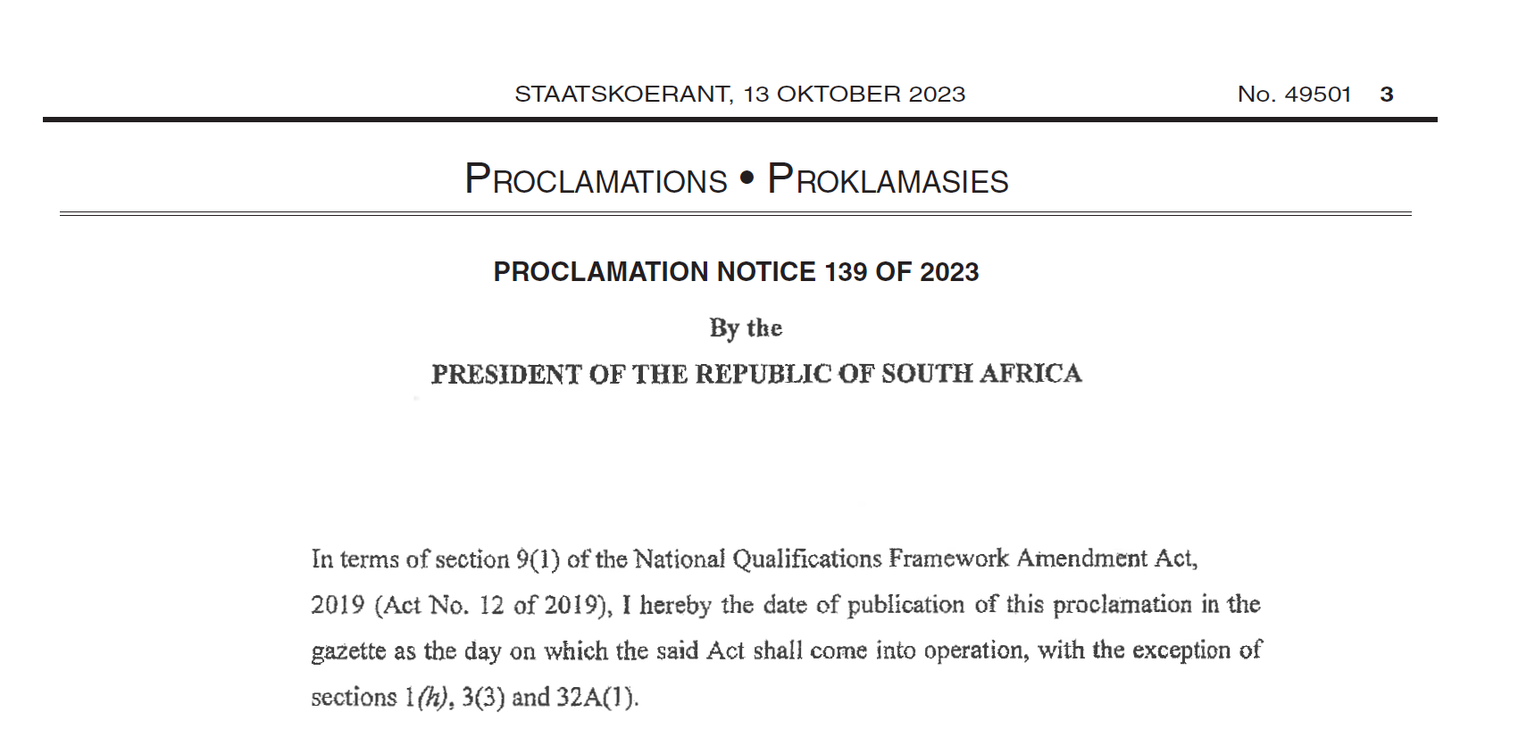
The NQF Amendment Act no.12 of 2019

Slide 2

NQF Act
2008
Qualification means a registered qualification and all qualifications must be registered on NQF
National qualifications must be quality assured by one of 3 Quality Councils
NQF Amendment 2019
Misrepresented qualification is one “which is not authentic”
Provide an evaluation and advisory service for Foreign qualifications consistent with this Act
Provides for NQF, SAQA and Quality Councils
Objectives of integration; access and mobility, quality and redress, contribute to personal, social and economic development
Authentic FQ is
1) lawfully obtained and
2) evaluated by SAQA
Authentic national qualification is:
1) Registered on NQF
2) Accredited institution
3) Lawfully obtained
Maintain a separate register of professional designations;
To misrepresent is an offence that attracts penalty and referral (where prescribed)

Slide 3
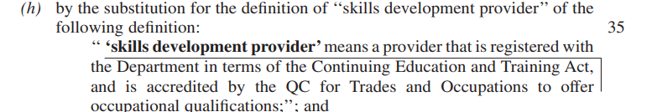
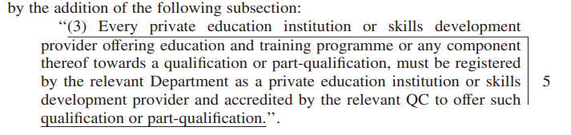
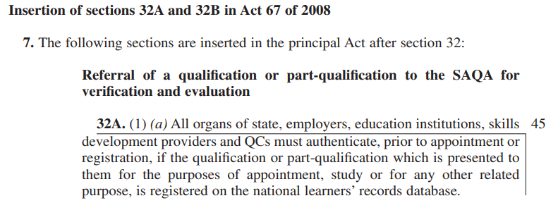

Slide 4
Recommendations for NQF Further Amendment Bill 2021/ Regulations
Data loads
Misrepresentation
Registration (Qualifications and Professional Bodies)
System of Collaboration and Review

Slide 5

THANK YOU

