Slide 1


Awarding of SAQA Professional Body Recognition and Re-recognition Certificates
Dr Makhapa Makhafola
Chief Operating Officer: SAQA

Slide 2

Handing over of Certificates
Re-recognition of fifteen (15) professional bodies and the re-registration of their designations.
Recognition of one (1) new professional body and the registration of its professional designations.

Slide 3
Re-recognition of fifteen (15) professional bodies and the re-registration of their designations

Slide 4
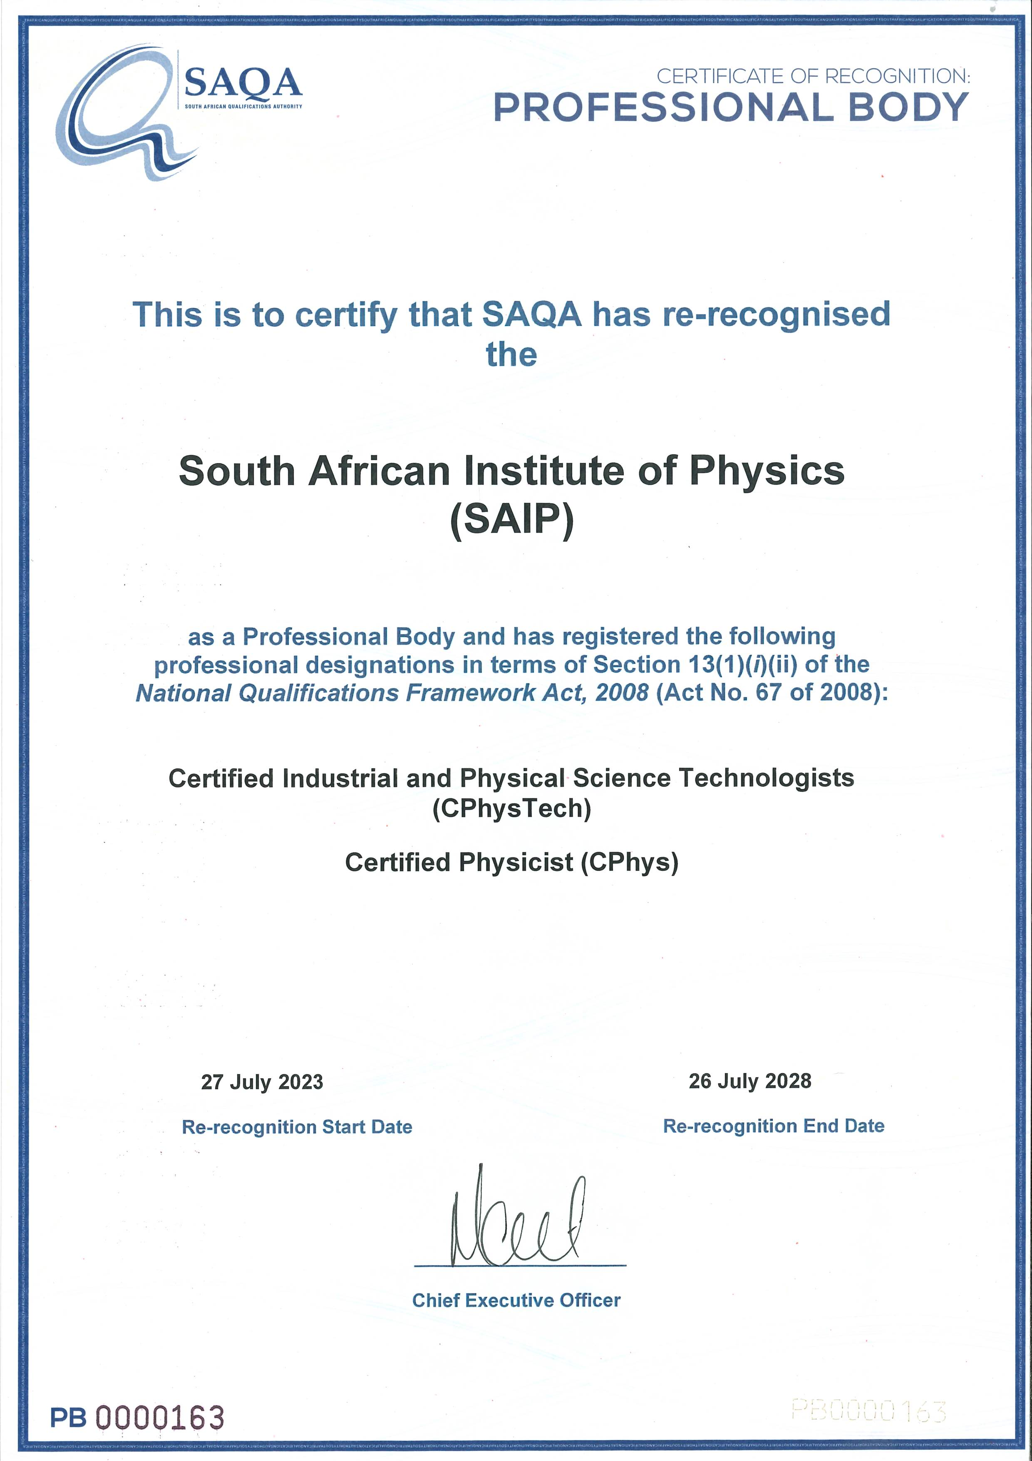

Slide 5
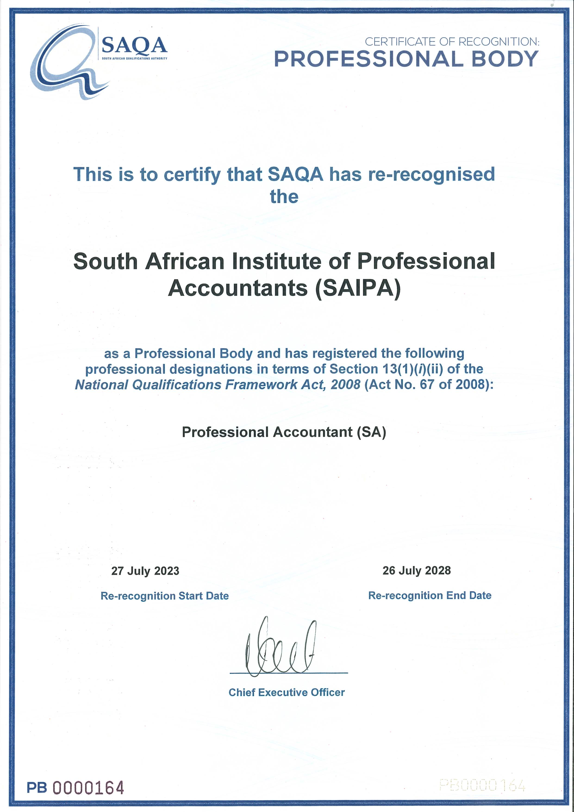

Slide 6
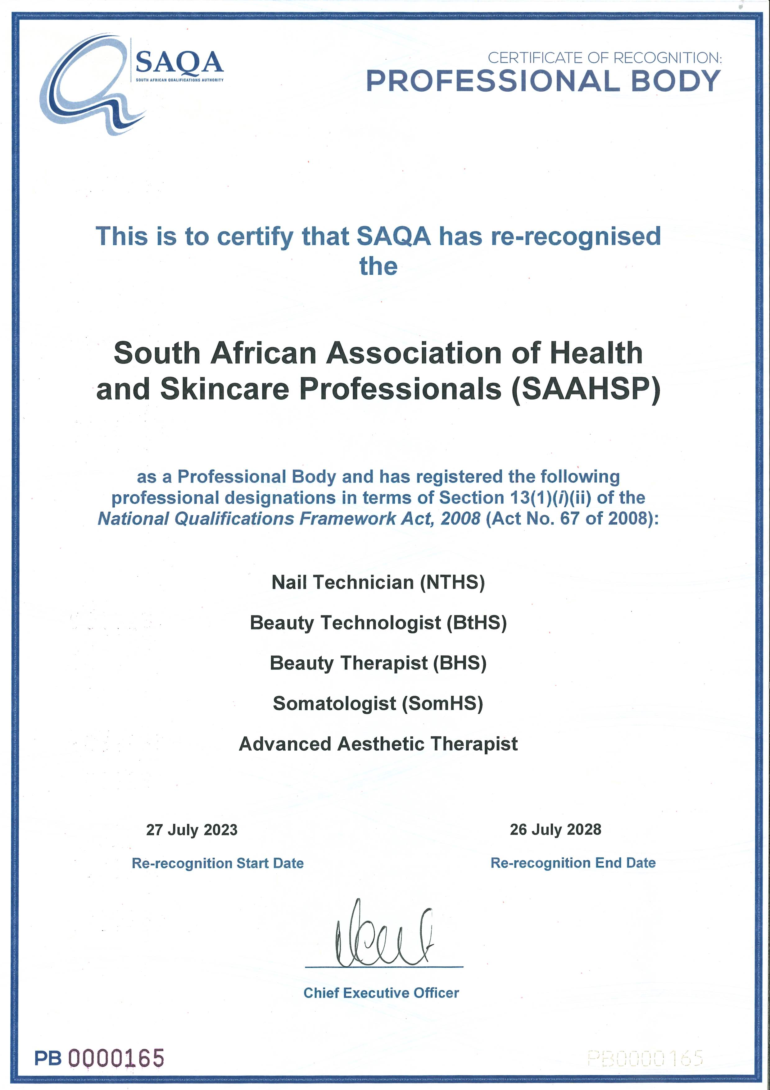

Slide 7
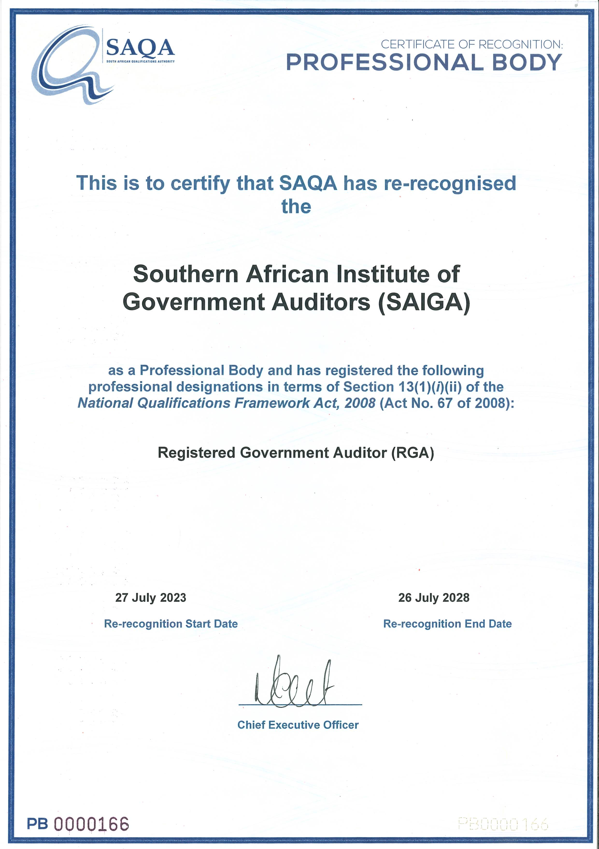

Slide 8
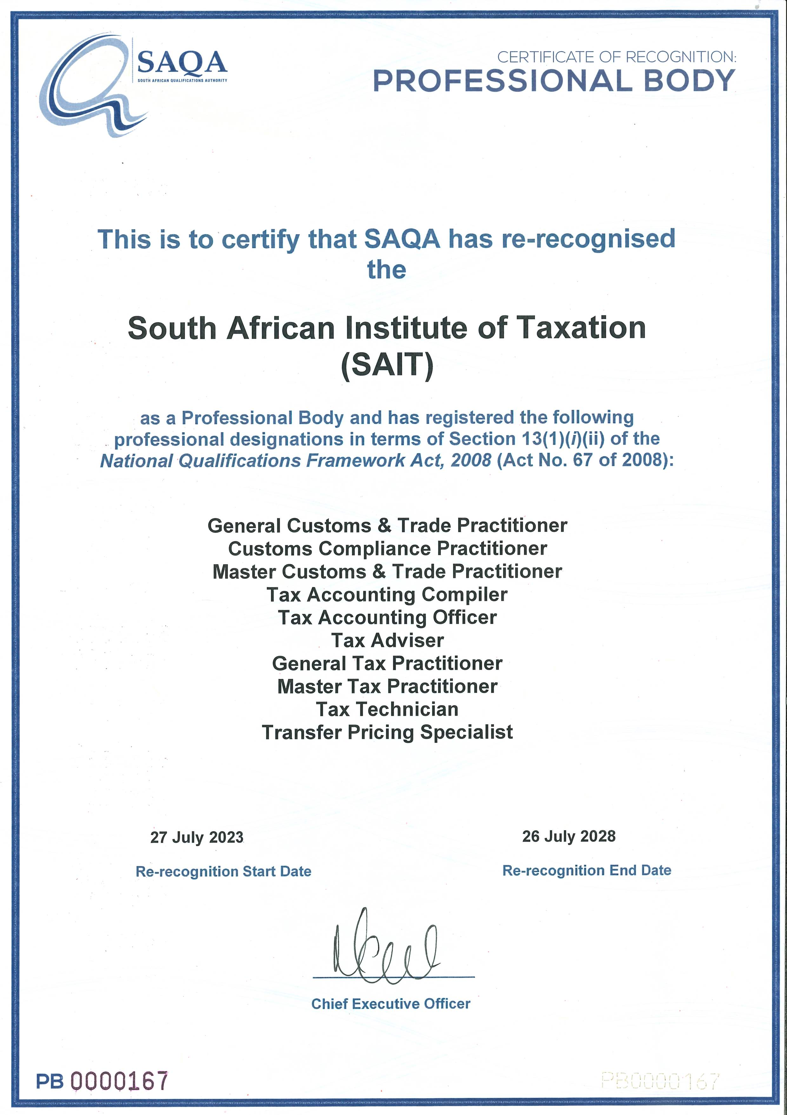

Slide 9
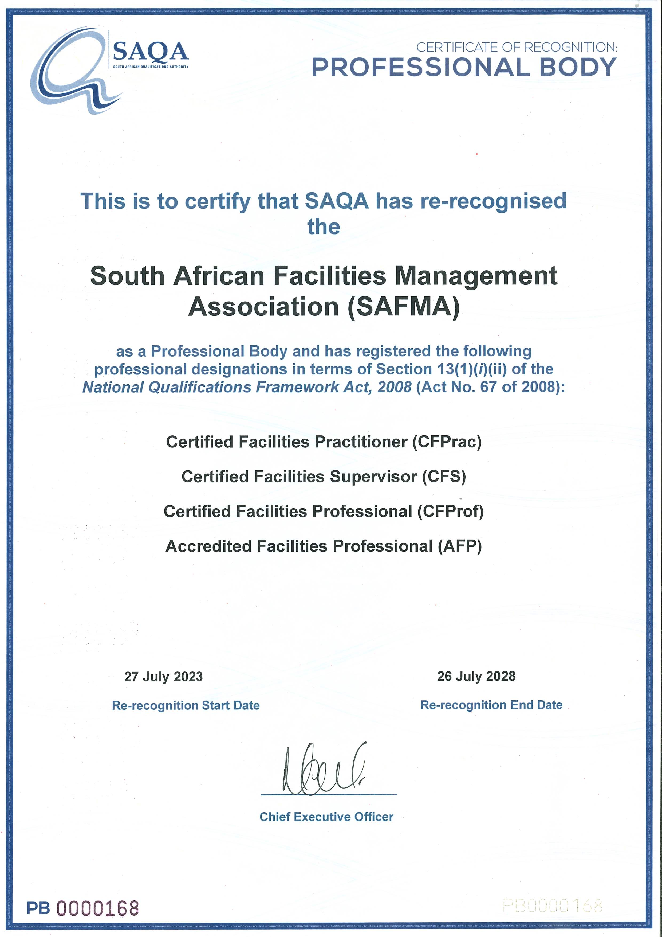

Slide 10
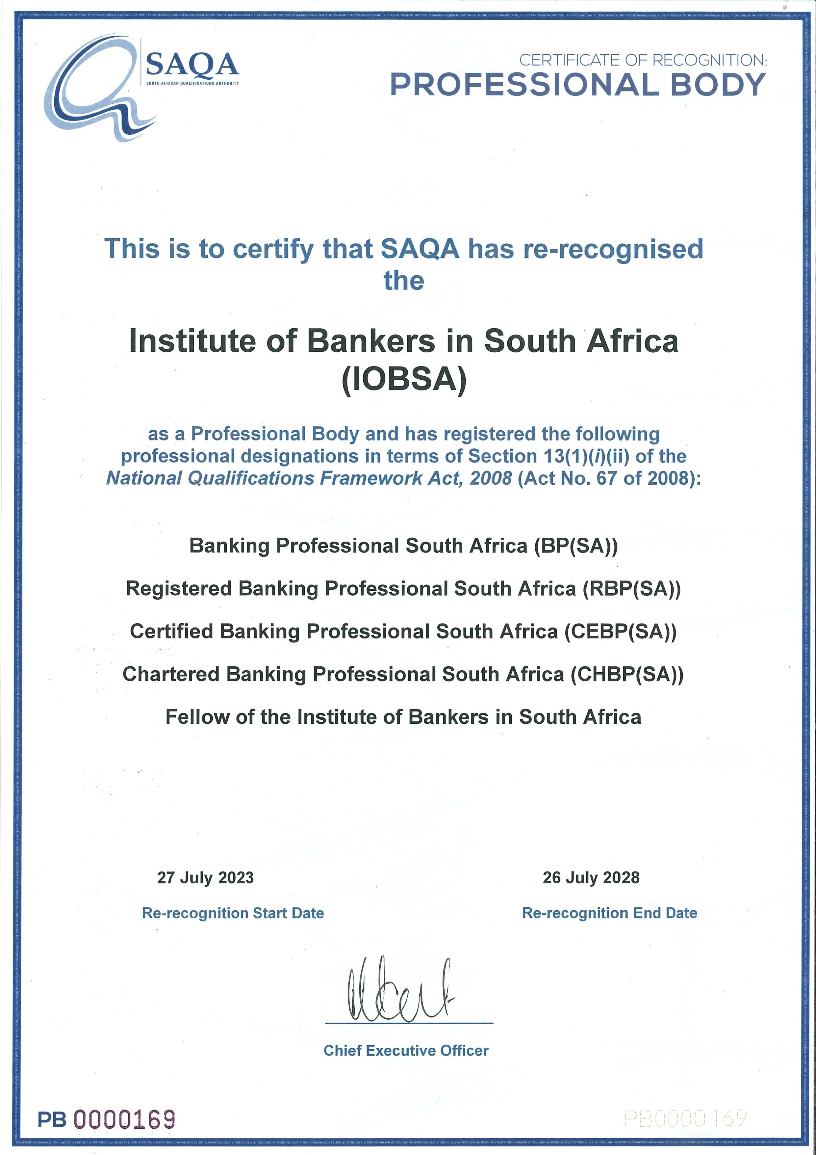

Slide 11
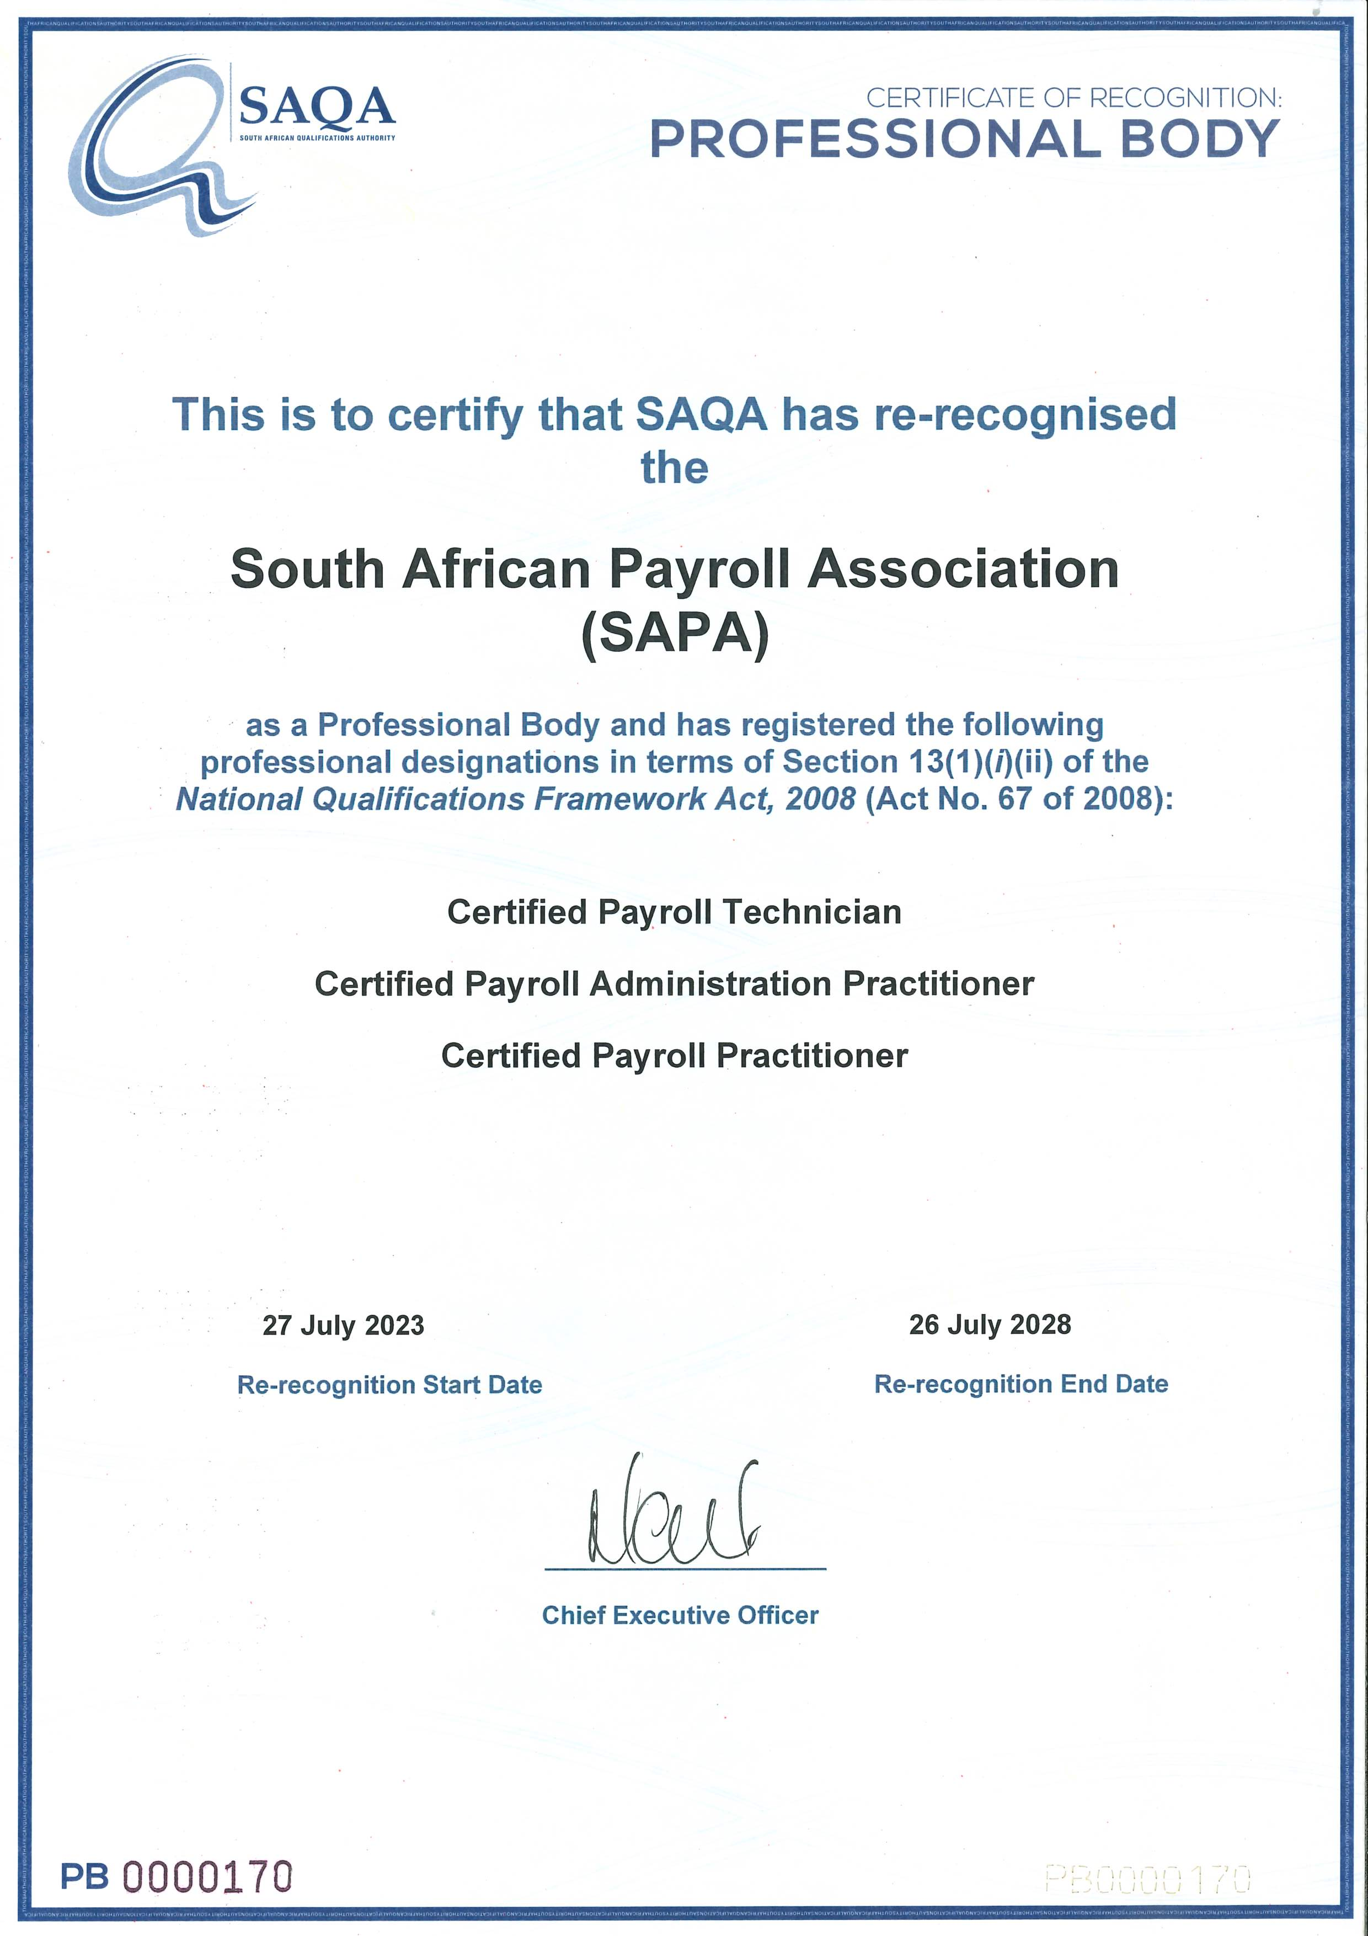

Slide 12
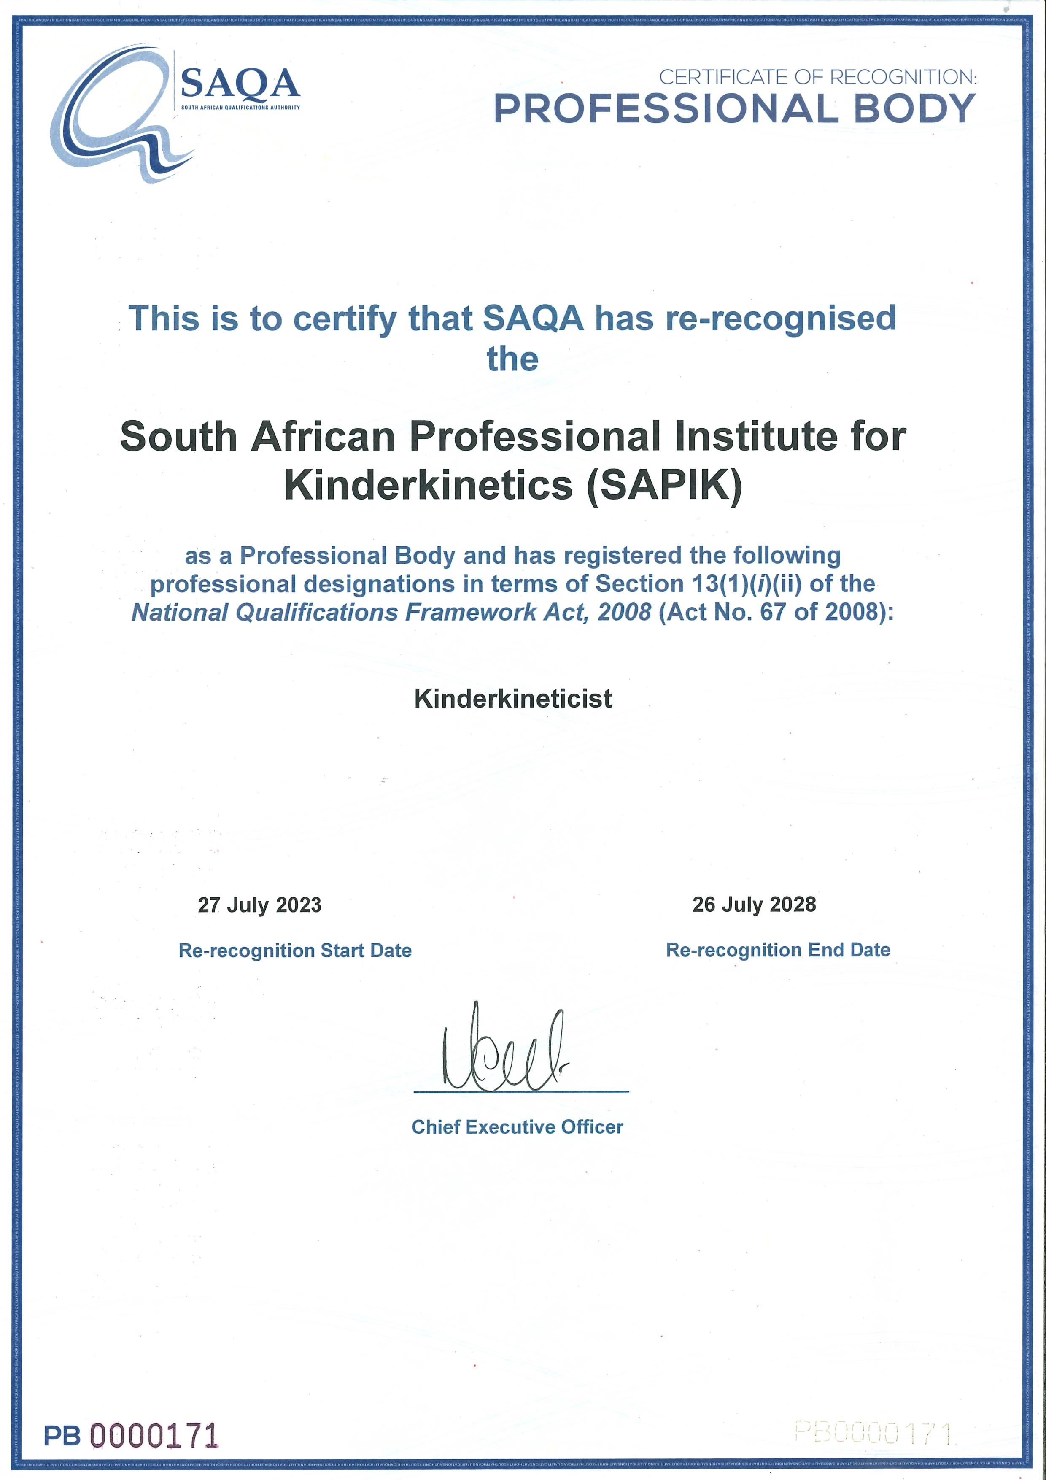

Slide 13
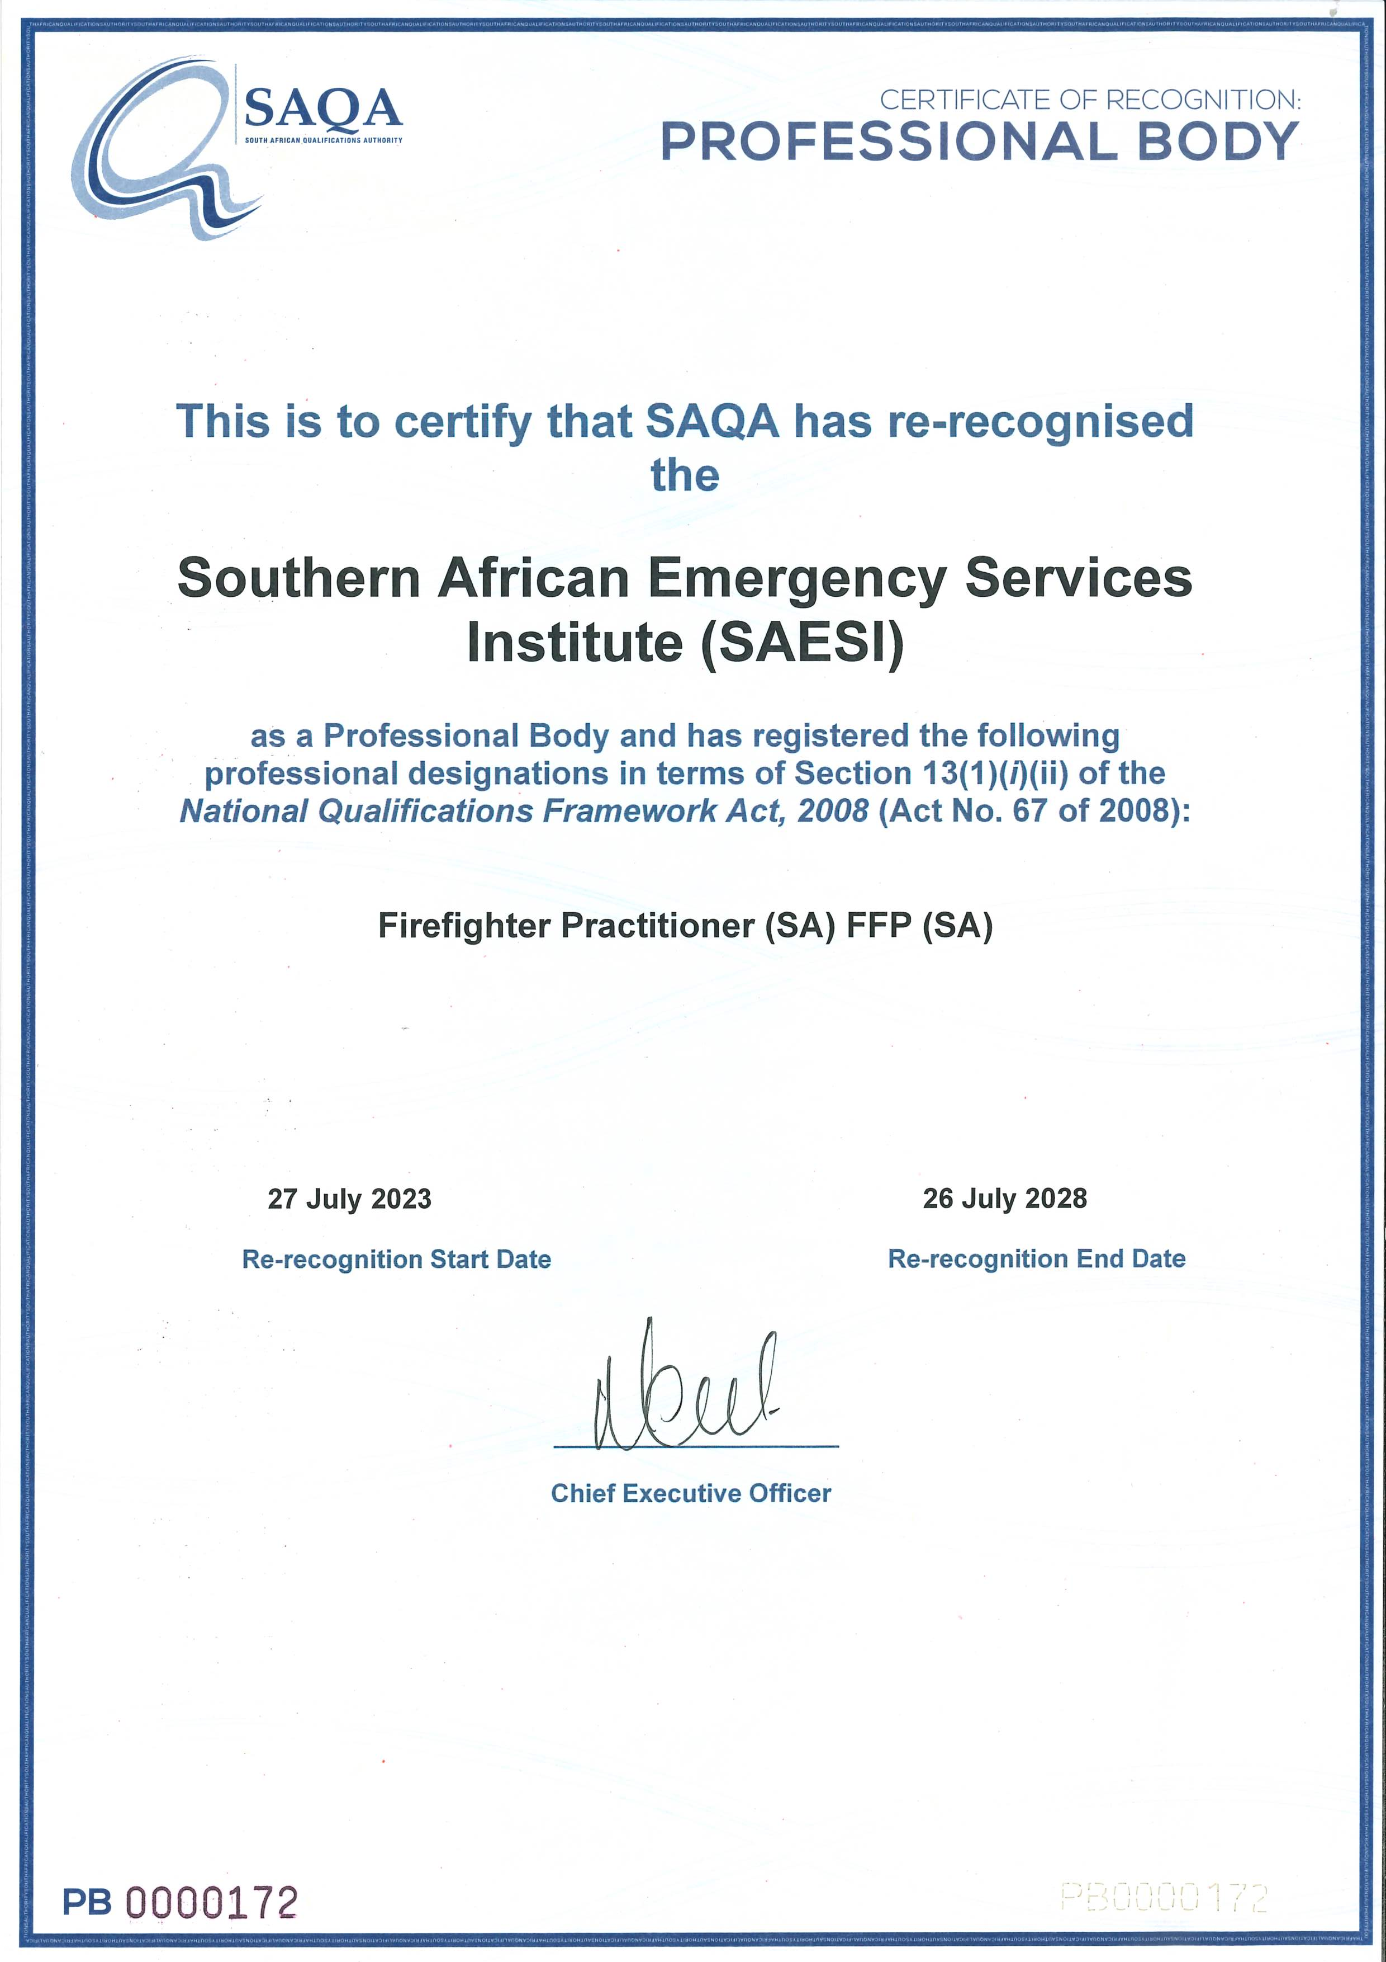

Slide 14
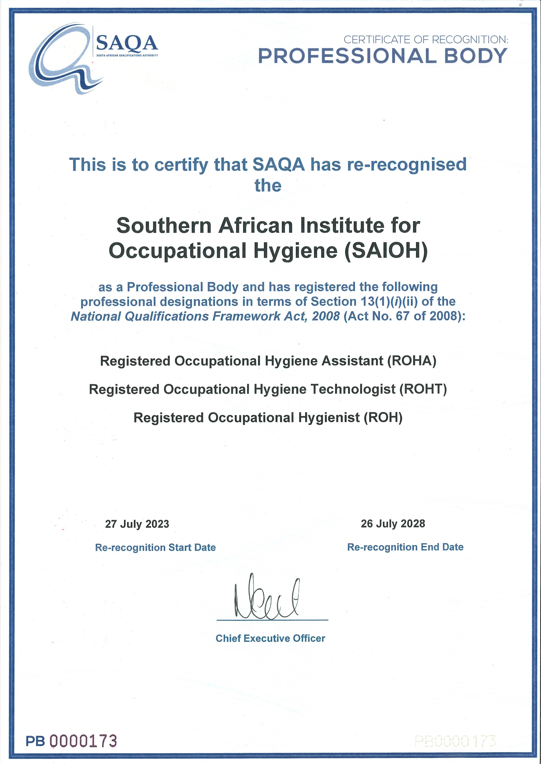

Slide 15
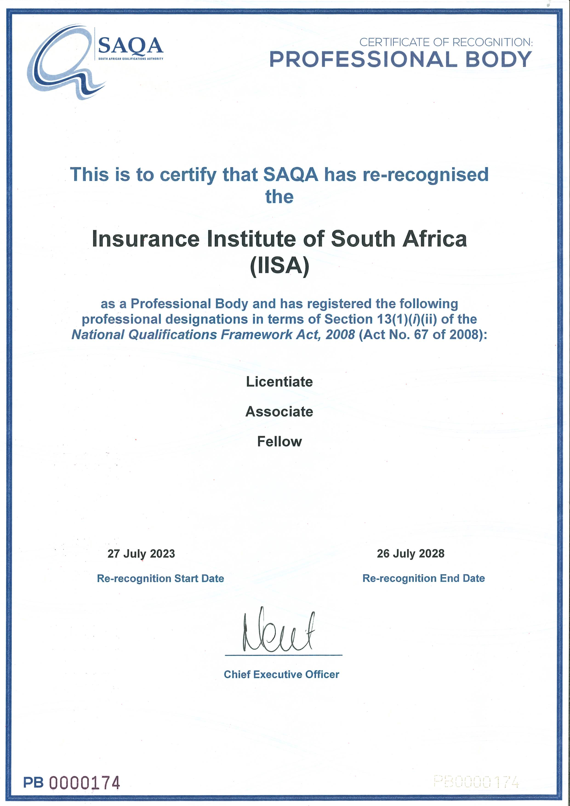

Slide 16
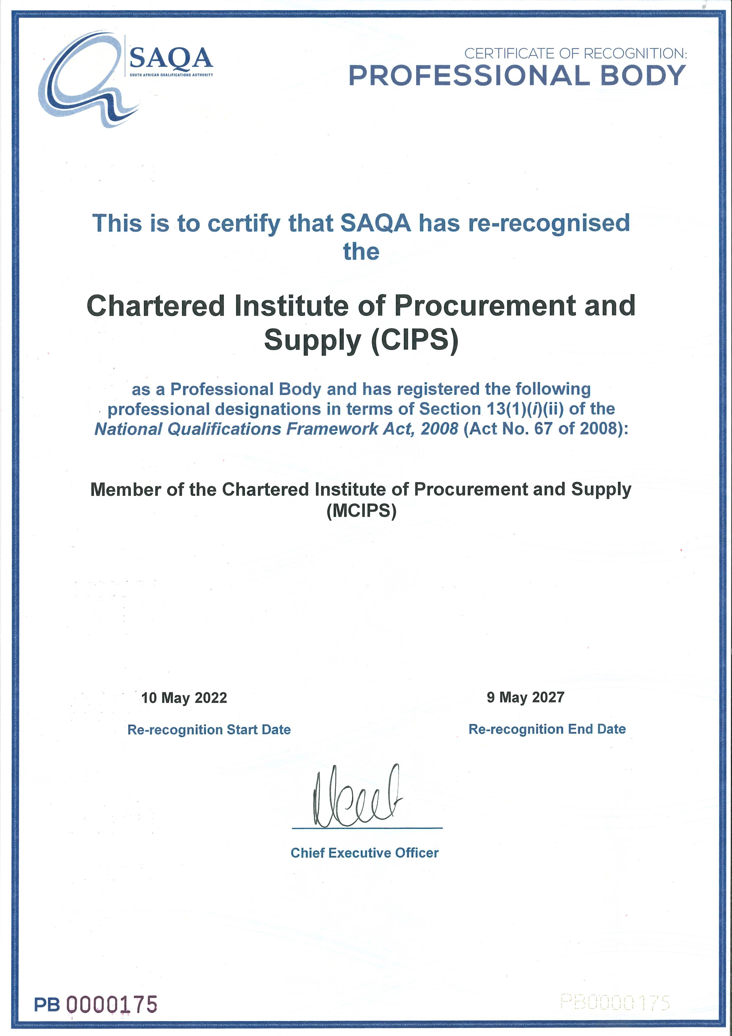

Slide 17
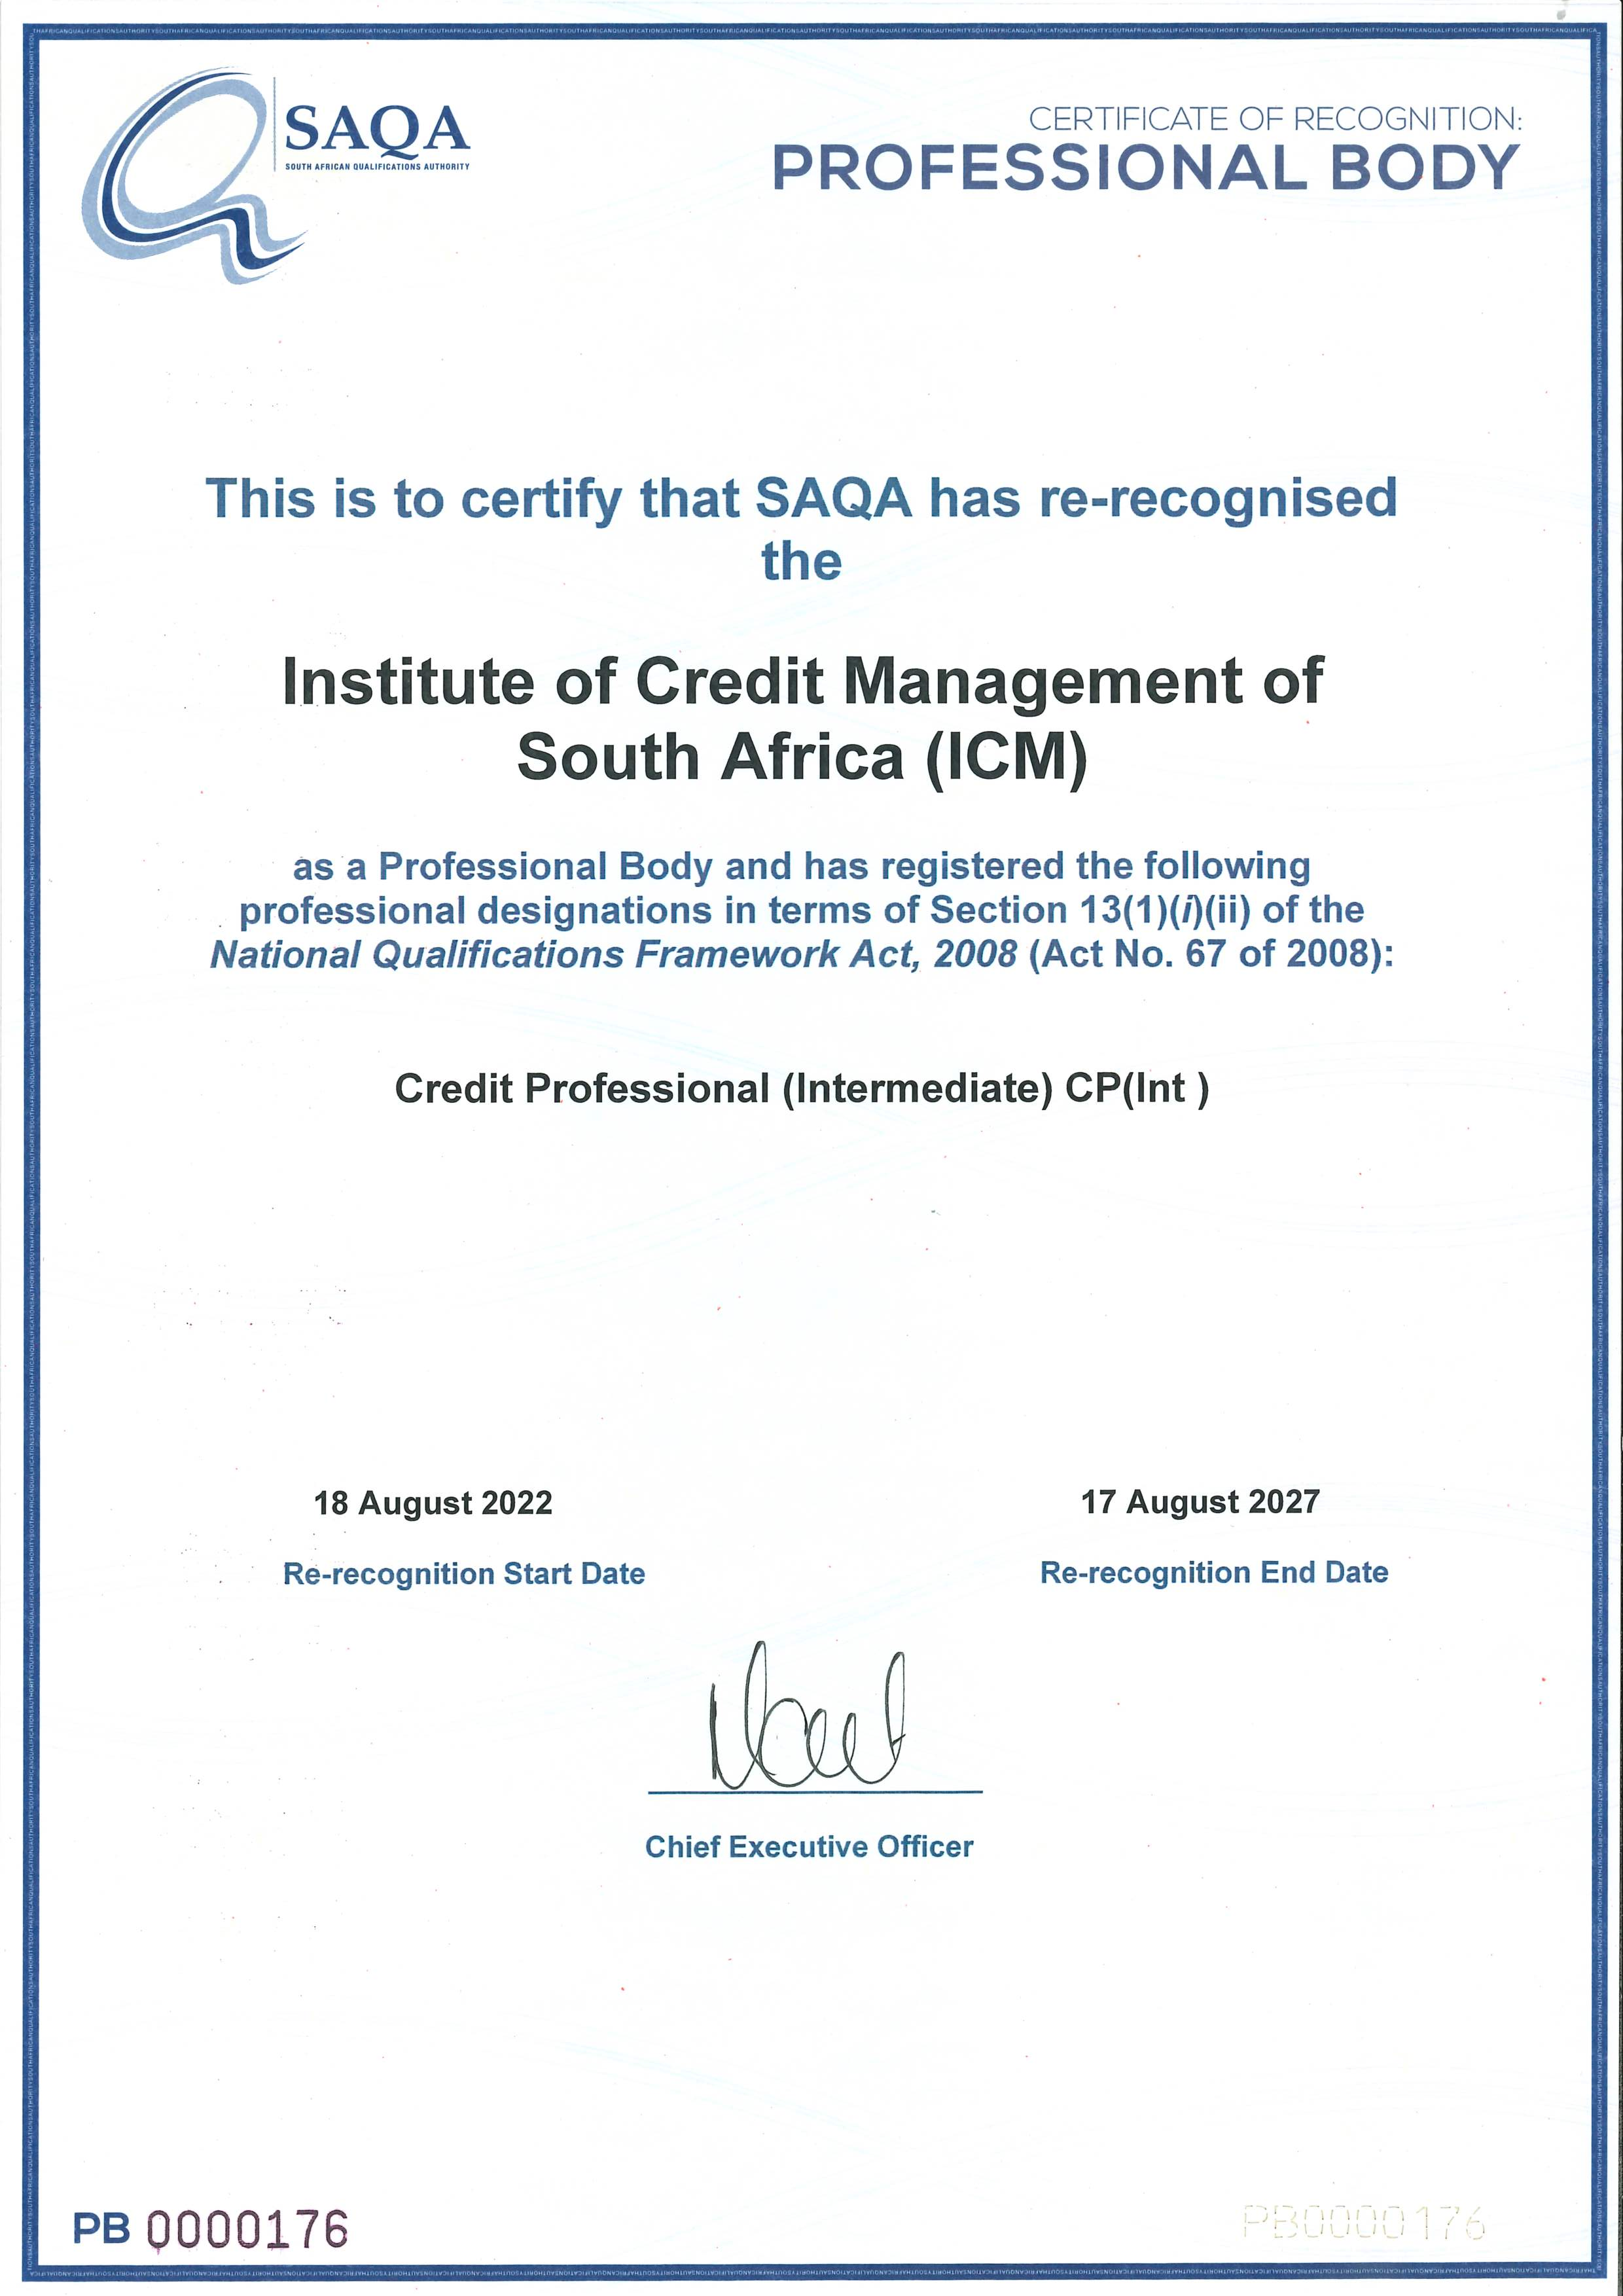

Slide 18
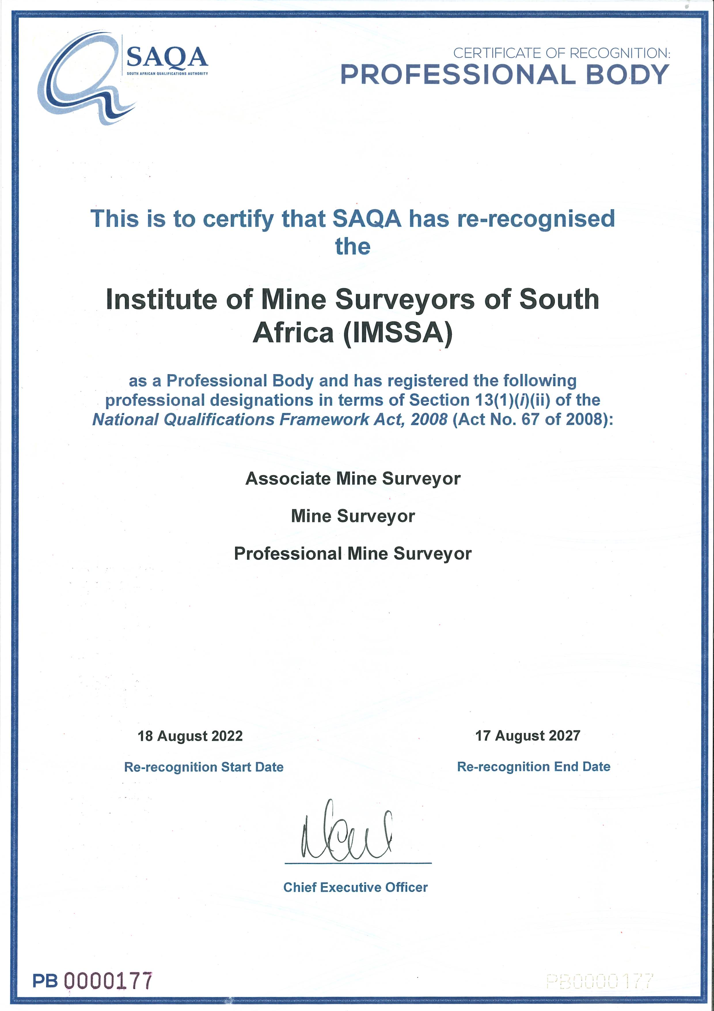

Slide 19
Recognition of one (1) new professional body and the registration of its professional designations

Slide 20
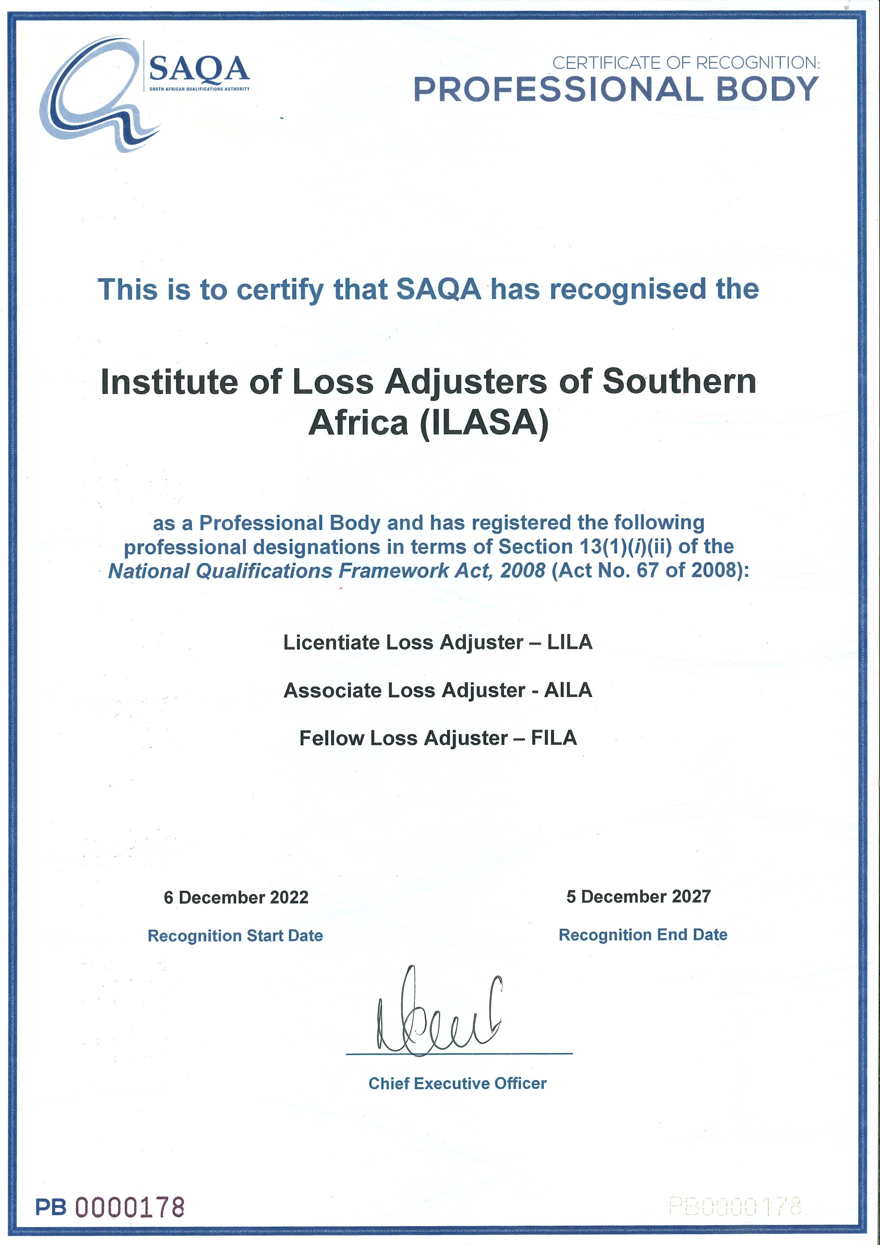

Slide 21

THANK
YOU

